Slide 1
How nutrition can influence breeding performances in dog ?
Aurélien GRELLET, DVM, PhD
Toulouse National Veterinary School
Toulouse, France

Slide 2

What does it mean « good breeding performances » ?

Slide 3
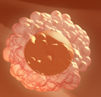

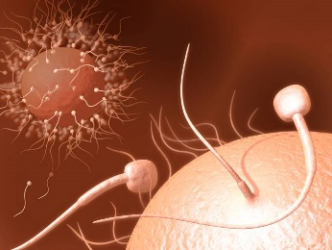
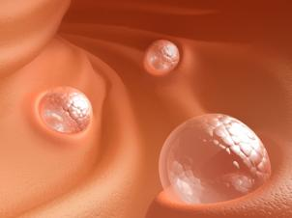
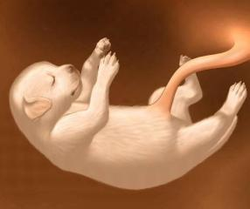
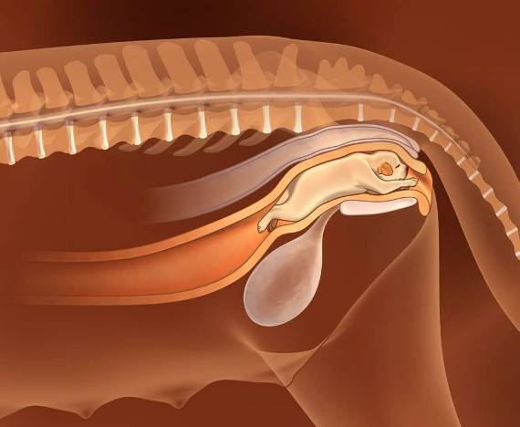


Good breeding performances if…..
Good ovocyte quality
High number of ovocytes
A lot of healthy puppies with a healthy mother
No embryonic
death
No foetal
death
No dystocia
Healthy female
Good body condition
Good milk
(quality + quantity)
No neonatal death
Good birth weight
Optimal growth
Healthy puppy
Good semen quality
Good mobility High concentration Normal morphology

Slide 4
How food can influence breeding performances ?

Slide 5
How food can influence breeding performances ?
Ingredients
Intentionally introduced substances
Nutrients Fat/Proteins/Carbohydrates/Vitamins/Minerals
Food additive
Preservative, flavors
Unintentionally introduced substances
Biological :
Mycotoxins, viruses, parasites, bacteria
Chemical :
Pesticide residues, vet drugs containants, environmental contaminants…)
Diet
Storage
Animal
Temperature
Humidity
Packaging
Time
Cleanliness
Insects rodents
Digestion
Nutrient profiles
Ingestion
Formulation
Absorption
Process
Quantity
Nutritional needs
Maintenance
Reproduction
Oestrus
Gestation
Lactation
Growth
Semen quality

Slide 6

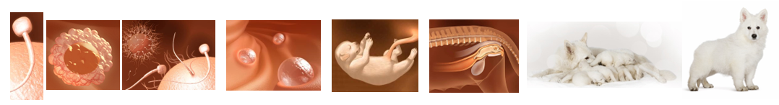
Link between food and breeding performances
Quality
Food
Quantity
Decrease
No effect
Improve
Breeding performances

Slide 7
Link between food and breeding performances
Quality
Food
Quantity
Decrease
No effect
Improve
Breeding performances

Slide 8

Case report of primary anoestrus
2 years old
No sign of heat since birth
No induction of oestrus after treatment by the vet
Feed with BARF
  Cattle bone and meat of the head and neck
  Since birth
Hasan B. et al. Primary anoestrus due to dietary hyperthyroidism in a miniature pinscher bitch. Can Vét J 2014, 55 : 781-785

Slide 9
Case report of primary anoestrus
Hyperthyroidism
Total T4 (nmol/L)
BARF
Commercial dog food
X 30 !!!
D0
D15
D21
D53
Hasan B. et al. Primary anoestrus due to dietary hyperthyroidism in a miniature pinscher bitch. Can Vét J 2014, 55 : 781-785

Slide 10
Case report of primary anoestrus
BARF
Commercial dog food
D13 Oestrus
5 puppies
D0
D15
D21
D53
Hasan B. et al. Primary anoestrus due to dietary hyperthyroidism in a miniature pinscher bitch. Can Vét J 2014, 55 : 781-785

Slide 11
Raw meat diets → nutritional concerns and safety risk
Nutritional concerns
Safety risks
60 %
Major nutritional imbalances
21 – 48 %
Contaminated by Salmonella sp
95 homemade raw meat diets analyzed
Campylobacter spp
Toxoplasma gondii
Freeman L et al. Current knowledge about the risks and benefits of raw meat-based diets for dogs and cats. JAVMA, 2013, 243 (11) : 1549-1558

Slide 12
Link between food and breeding performances
Food
Quality
Quantity
Decrease
No effect
Improve
Breeding performances

Slide 13
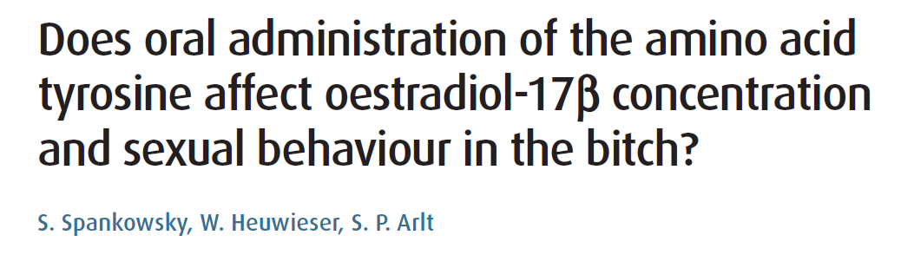

Supplementation of bitches with tyrosine has no effect bitches sexual behaviour.
+
Hypothalamus
Tyrosine
(Amino acid)
GnRH
+
Pituitary gland
Tyrosine
100 mg/kg/day
day 3 to 9 of heat
FSH
LH
+
Ovaries
No effect on :
Visual signs of heat
Copulation behaviour
Oestradiol concentration
Oestrogen
Progesteron
Sexual behavior

Slide 14
Link between food and breeding performances
Quality
Food
Quantity
Decrease
No effect
Improve
Breeding performances

Slide 15

Consequences of an excess of food ingestion
Excess of food ingestion
Overweight
Obesity

Slide 16
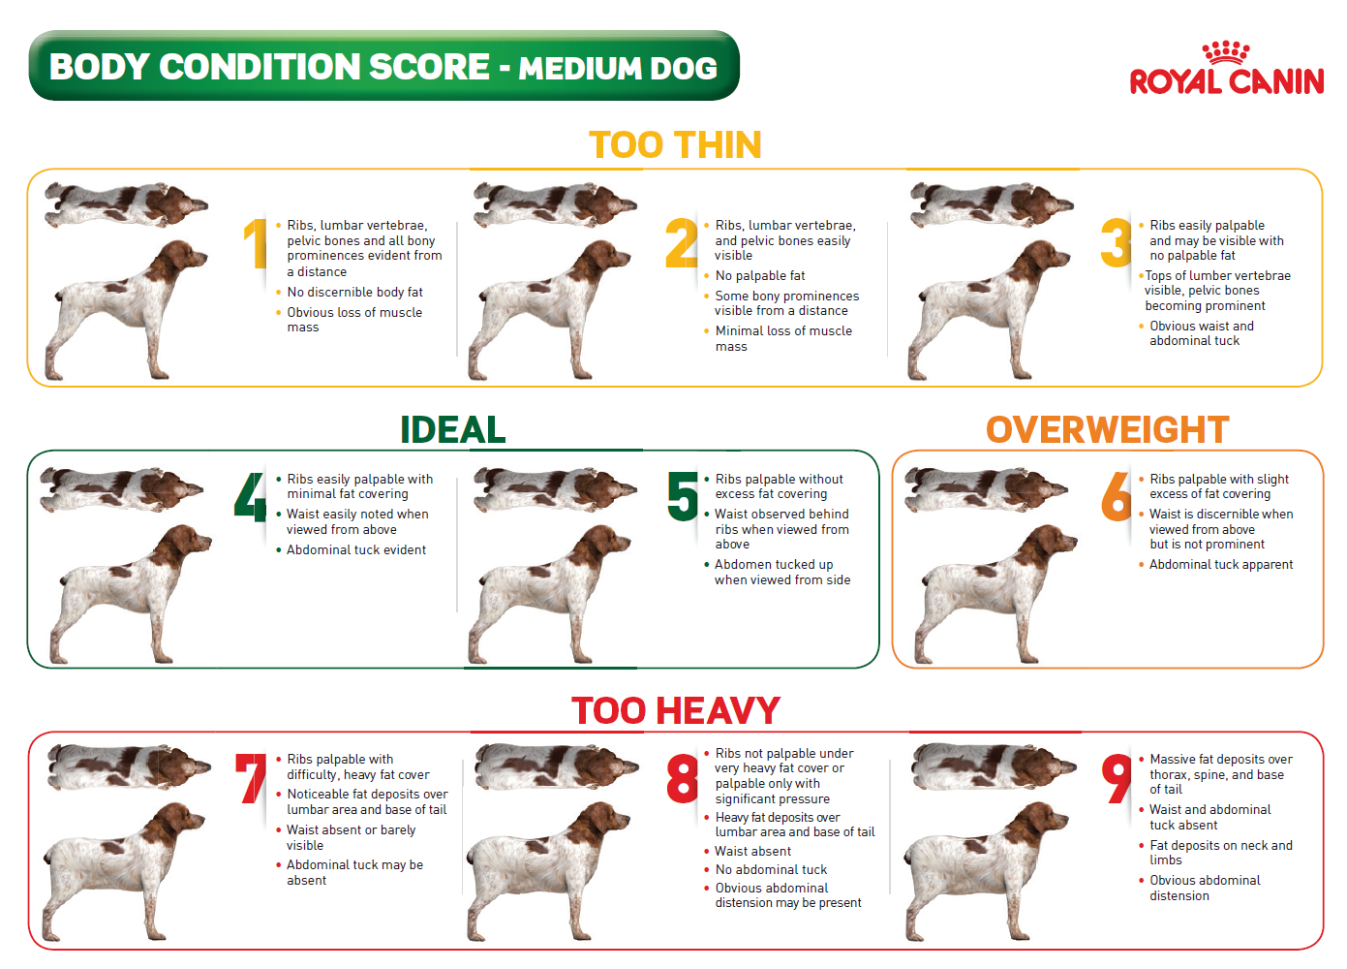
Notes:
Today the body condition score is evaluated thanks a 9 points scale. A dog with a score at 4 or 5 is in an optimal body score. On the contrary a dog with a score of 1 is cachectic (no more fat) and a dog with a score of 9 is obese.

Slide 17
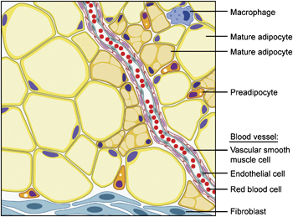
Leptin : a peptide hormone secreted by adipocytes
Leptin
Notes:
Obese dogs have a higher quantity of fat. If we have a look on the composition of fat we can see that fat contained specific cells called adipocytes. Adipocytes are cell full of fat. Fat is an important endocrine tissue which can secrete different hormons one of them is leptin.

Slide 18
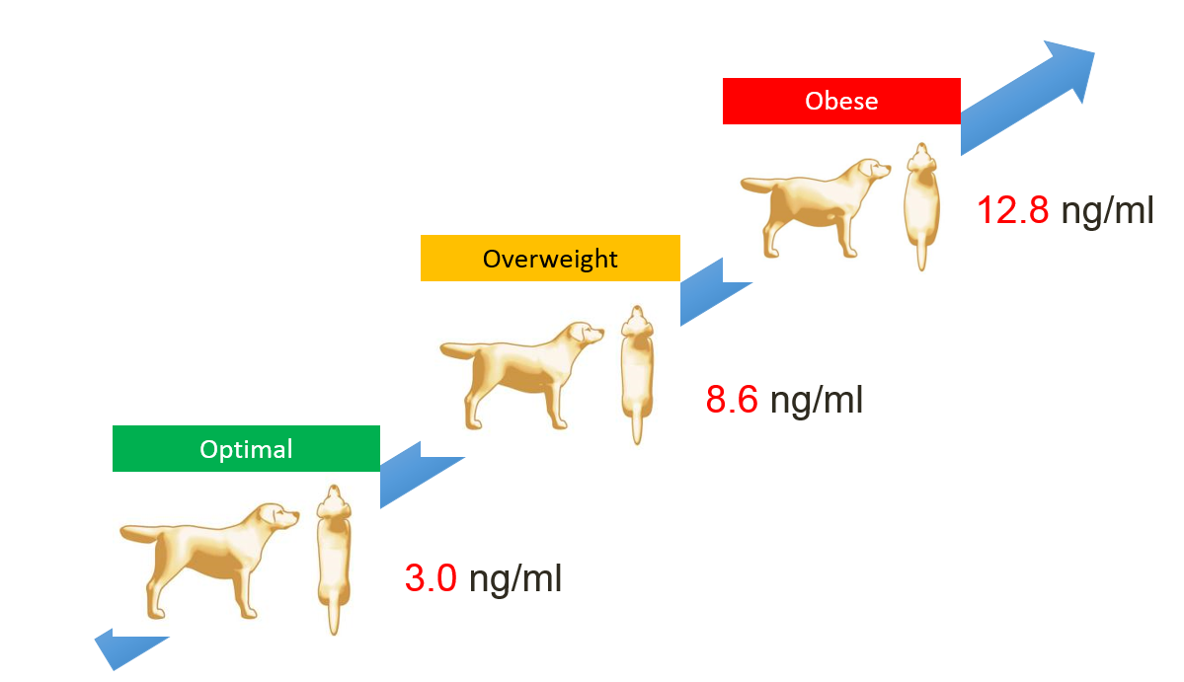
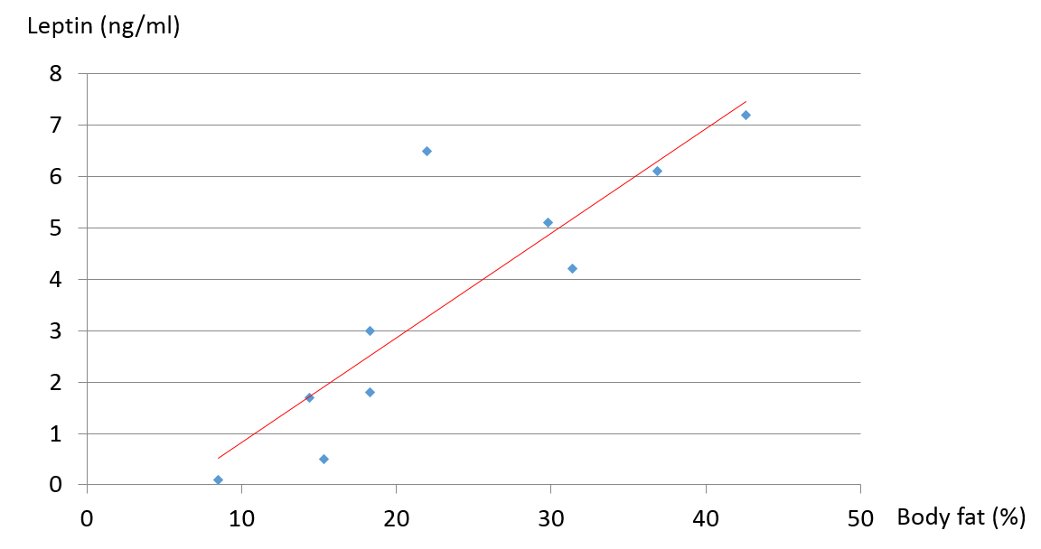
Leptin concentration is correlated to BCS and fat level
Leptin body condition score
Leptin body fat level
Ishioka K. et al. Plasma leptin concentration in dogs: effects of body condition score, age, gender and breeds. Research in veterinary science 82 (2007): 11-15
Ishioka K. al al. Experimental and clinical studies on plasma Leptin in obese dogs. J. Vet. Med. Sci. 2002: 64(4): 349-353
Notes:
Obese dogs have a higher quantity of fat. If we have a look on the composition of fat we can see that fat contained specific cells called adipocytes. Adipocytes are cell full of fat. Fat is an important endocrine tissue which can secrete different hormons one of them is leptin.

Slide 19

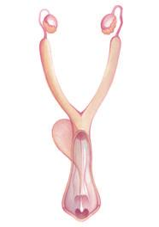

Obesity induces modifications in hormonal secretions
Leptin
GnRH
FSH, LH
Progesteron
Estrogen
Notes:
This increase level of leptin could interfere with the secretion of specific hormones like (GnRH, FSH, LH, Progesteron or Estrogen).

Slide 20
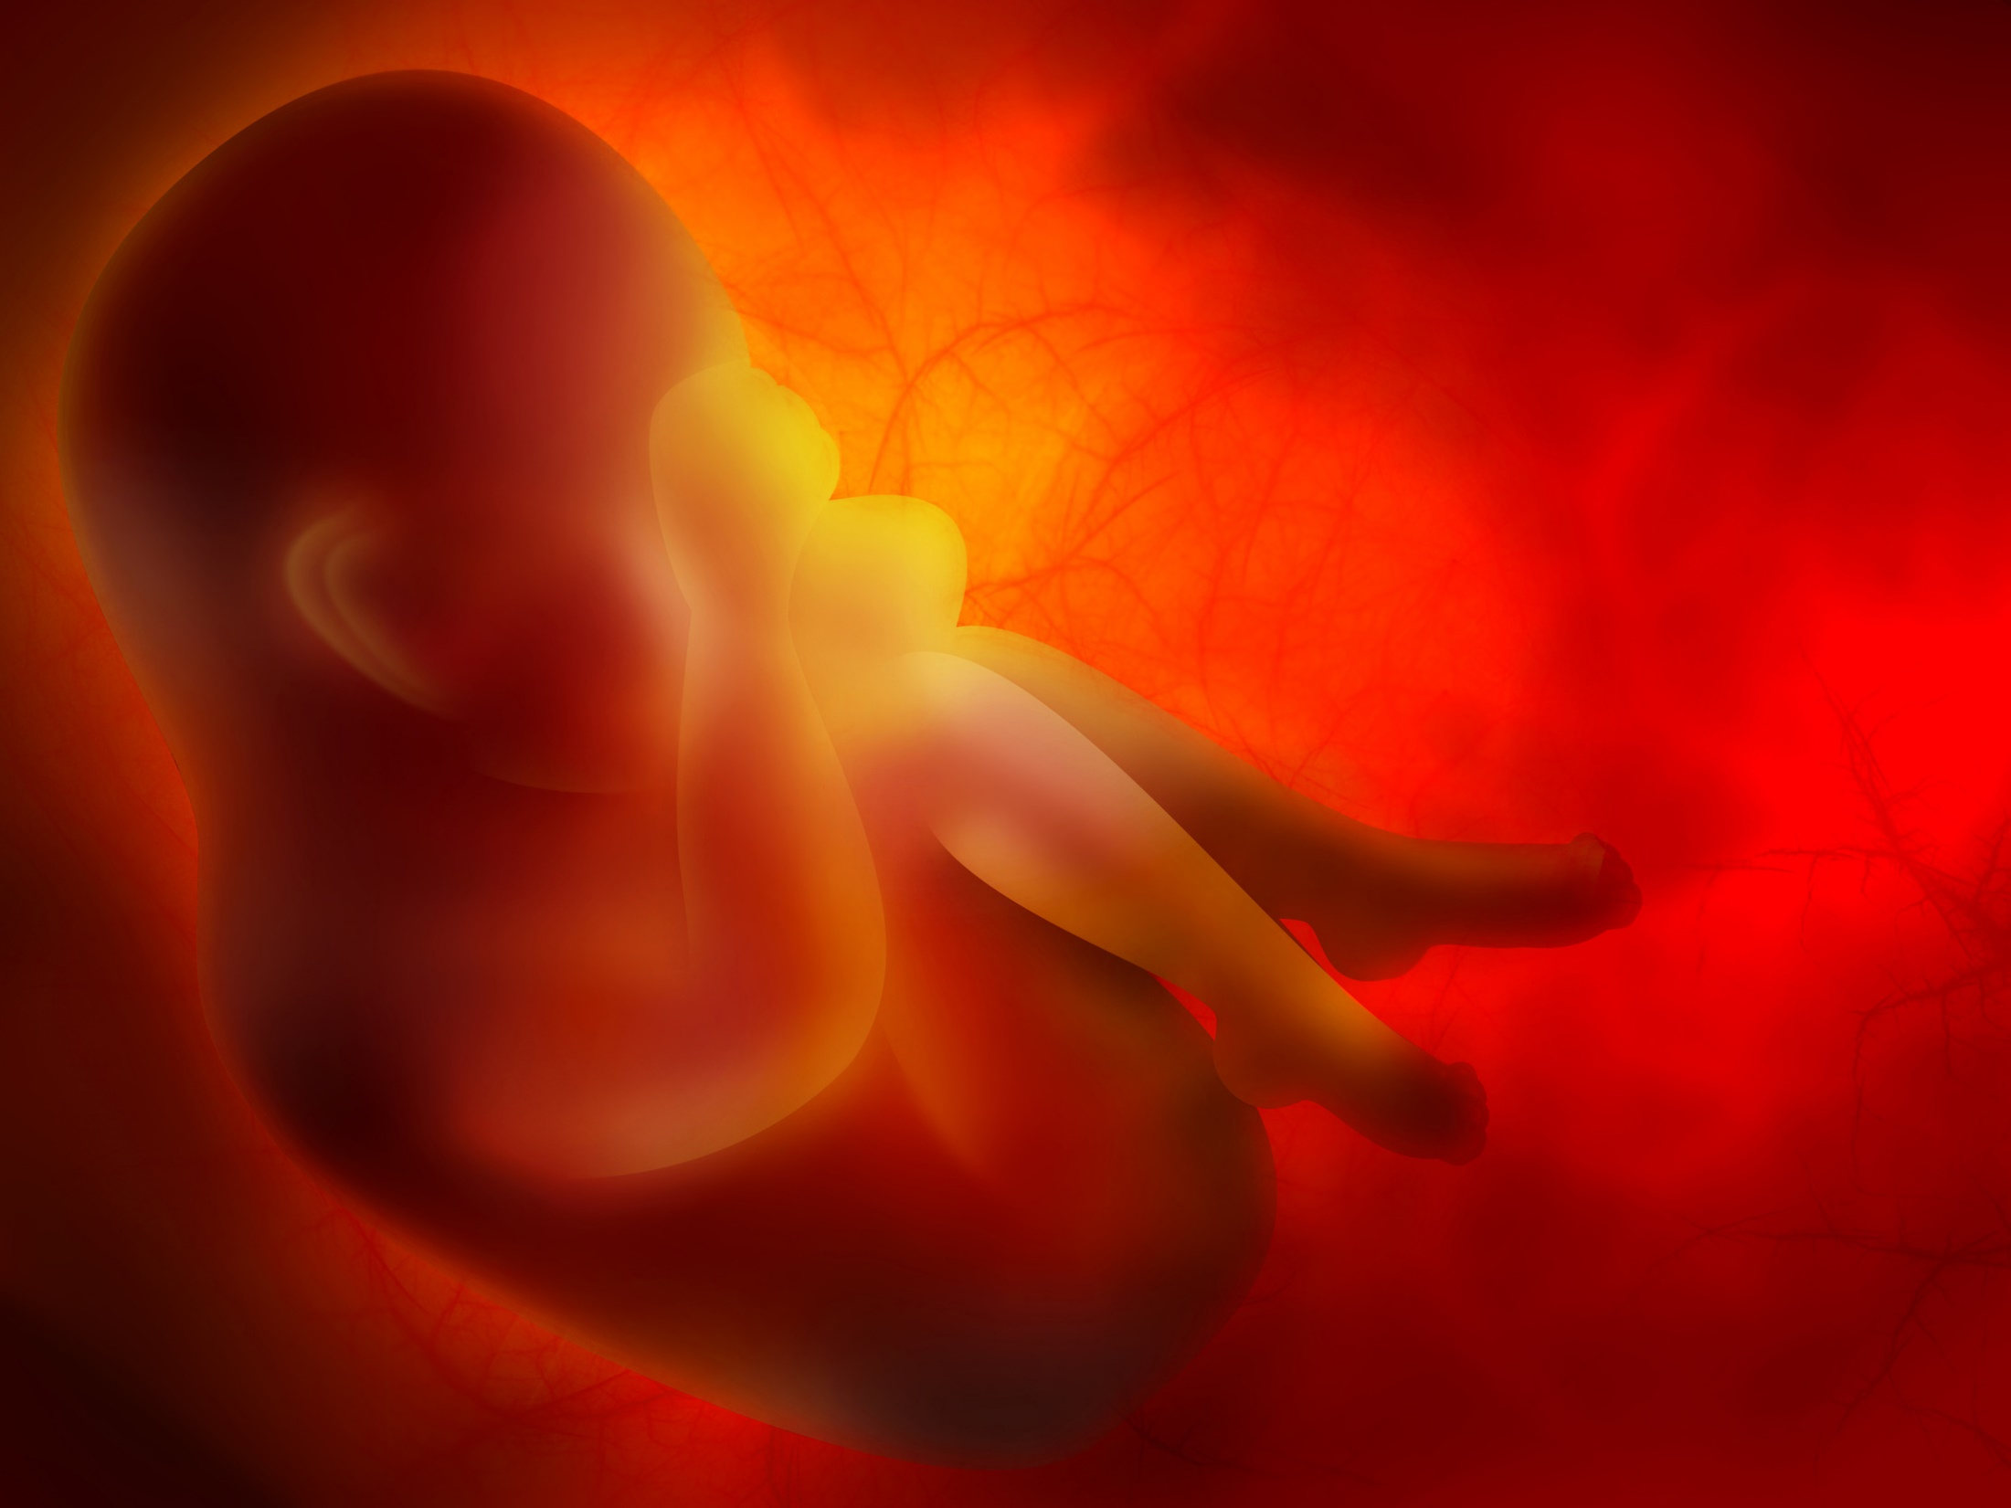
Obesity induces an inflammation of placenta in human
Obese
Inflammatory cells in the placenta
X 4
Lean
Challier JC. et al. Obesity in Pregnancy Stimulates Macrophage Accumulation and Inflammation in the Placenta. Placenta, 2008, 29 (3) : 274-281

Slide 21
Obesity
General and local inflammation
Hormonal dysregulation
Infertility

Slide 22
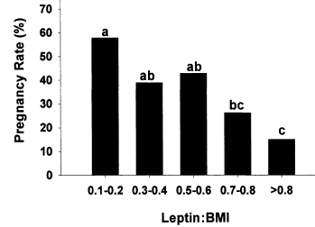
Obesity decreases fertility in human
Brannian JD et al. Baseline non-fasting serum leptin concentration to body mass index ratio is predictive of IVF outcomes. Human reproduction, 2001, 16, 9 : 1819-1826
Notes:
In human, different studies showed that obesity decrease the pregnancy rate as you can see with this study from Brannian.

Slide 23
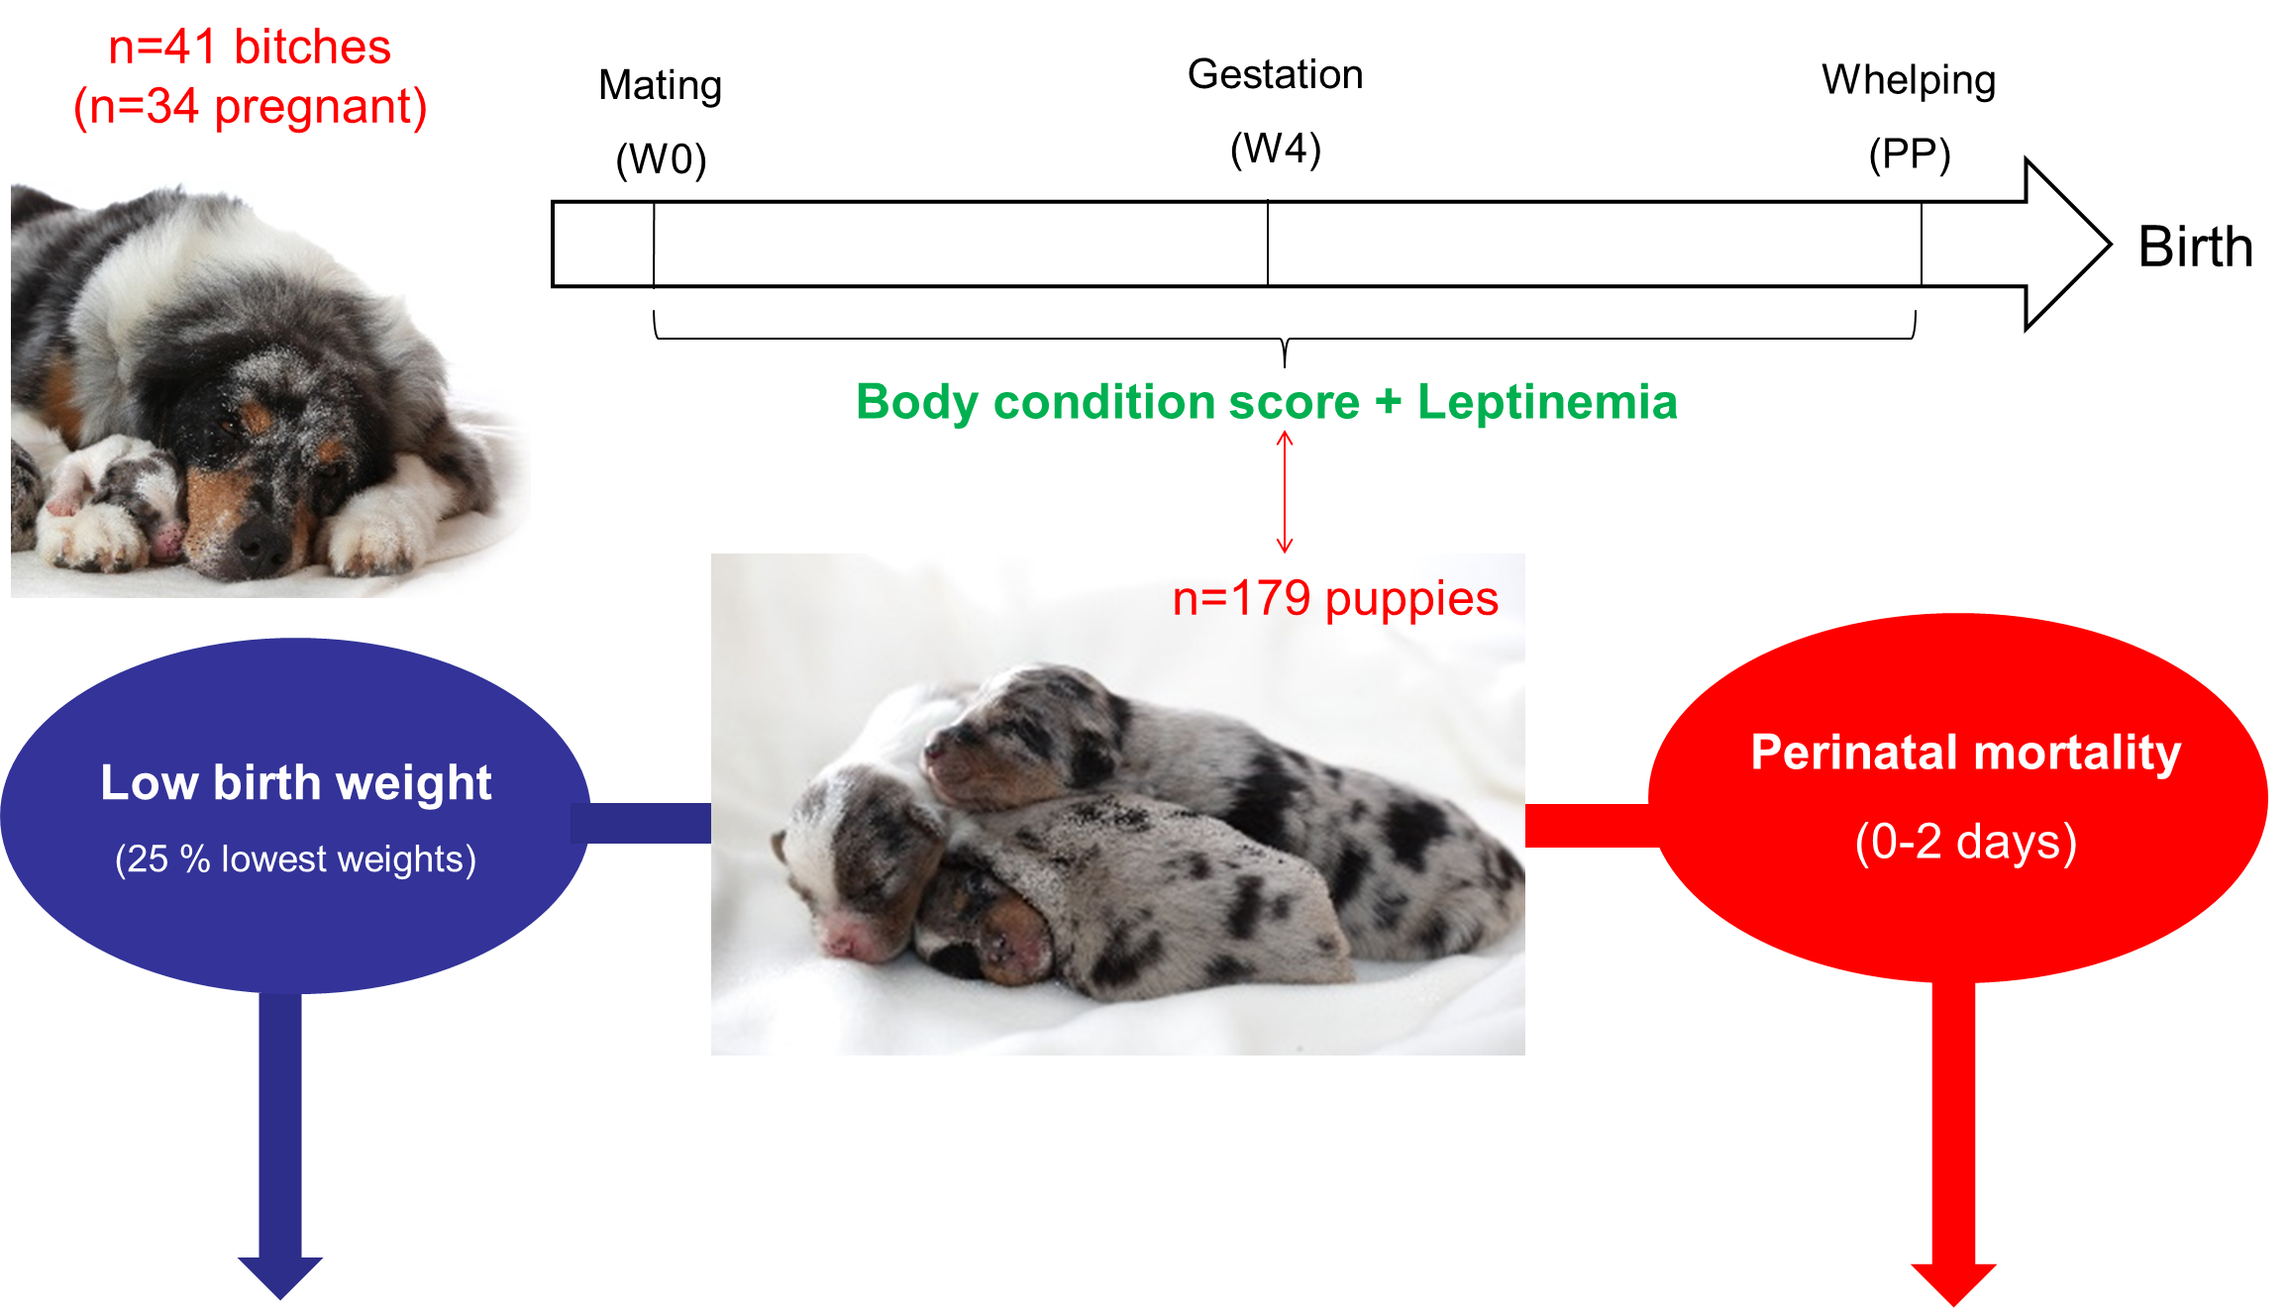
New study done in dog on BCS and reproduction

Slide 24
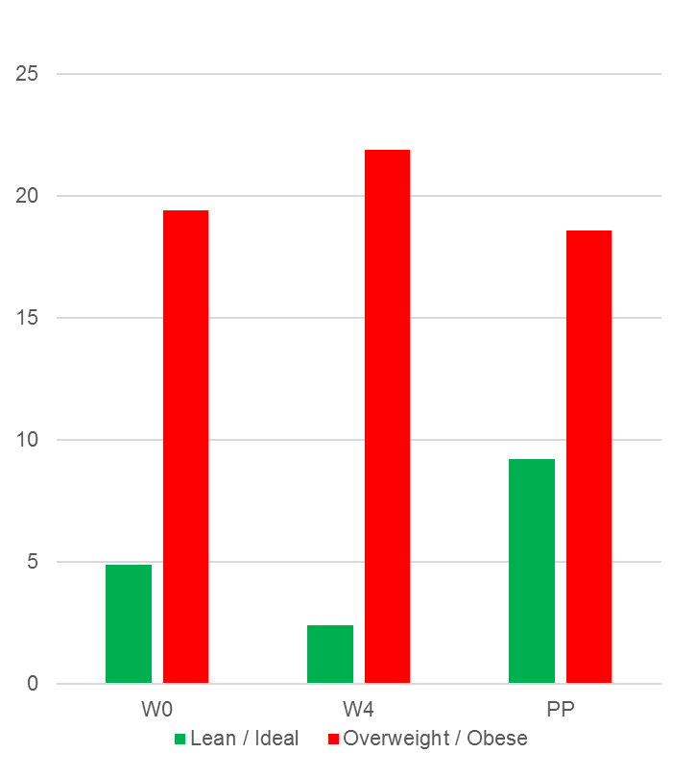
BCS influence prevalence of low birth weight and mortality
Prevalence of low birth weights
22,5 %
Perinatal mortality
25,1 %
Low birth weight puppies (%)
Mortality (0-2 days) (%)

Slide 25
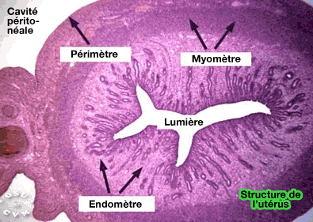

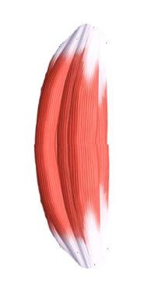
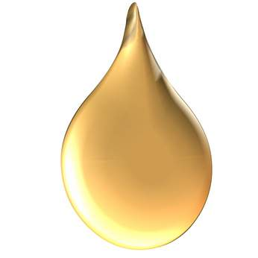
Overweight bitches accumulate fat in the uterus
Uterus has a muscle : myometra
Abdominal cavity
Limit of uterus
Myometra
Lumen
Endometra
Uterus
Notes:
25
One consequence of an excess of energy during pregnancy is that fat can be stocked in muscles.

Slide 26


In overweight women, a diminution of myometra contraction is observed
+
mN
Amplitude
mN
Frequency (10 minutes)
Zhang J. et al. Poor uterine contractility in obese women. BJOG 2007;114:343–348
Notes:
26
This accumulation of fat can decrease muscle contraction so uterine contraction. This phenomena was well described in women. As you can see on this figure from Zhang overweight and obese women present a diminution of uterine contraction as you can see here.

Slide 27
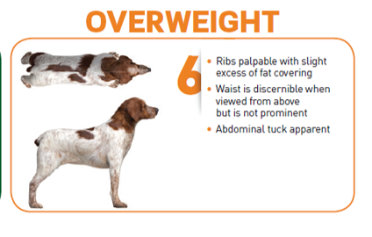
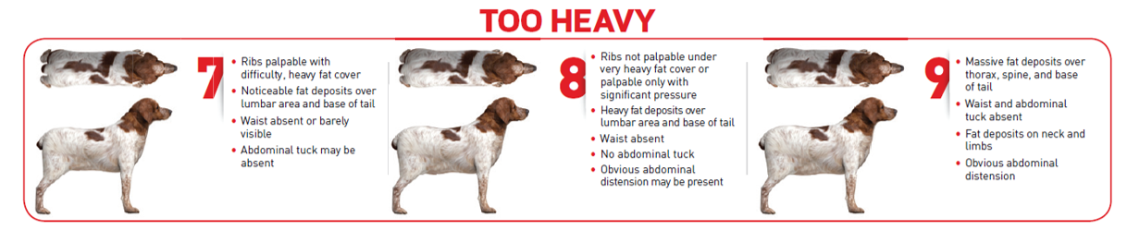
Overweight is frequent in pure breed dogs
Holland
(Winner show)
1379 dogs*
UK
(Crufts)
960 dogs**
France and Belgium
(world dog show)
482 dogs***
19 %
26 %
23 %
*Corbee RJ (2013). Obesity in show dogs. Journal of animal physiology and animal nutrition. 97, 5, 904–910
**Such, ZR., German, AJ. (2015) Best in show but not best shape: a photographic assessment of show dog body condition. Veterinary Record 177, 125.
***Unpublished results

Slide 28

Assessment of body condition score before the mating
Only healthy dogs in a good body condition score should be used for breeding
Notes:
So all the data underline the necessity to assess body condition score before the mating. Only healthy dogs in a good body condition score should be used for breeding.

Slide 29

How to feed the dog during pregnancy ?

Slide 30
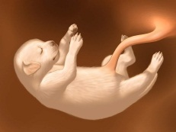
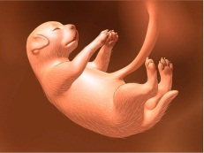
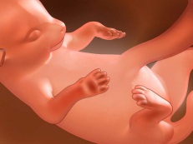
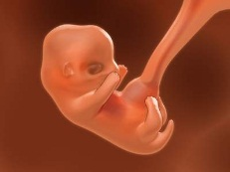
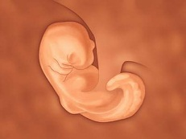
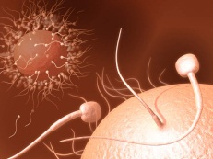

Foetal growth occurs at the end of pregnancy
time
35 days
63 days
Notes:
When we focus on dog’s gestation, we can demonstrate that gestation is divided into 2 pahes:
The first phase is called the embryo stage. During this 1st part of gestation (from fecondation until 35 days of pregnancy), the organs are going to appear. It is a qualitative stage. It means that at 35 days of gestation, the embryo has all the main organs (liver, heart, lungs…)
The second phase is called the fœtus stage. During this part (from 35 days until delivery), it is more a quantitative growth. It means that the fœtus is growing in size and in weight much more than during this embryologic phase.
So in 2 monts, we came from one cell (fusion of 1 spermatozoa & 1 ovum) to a puppy which will survive in its new environment.

Slide 31

Energy needs of the bitch increase from the 6th week of gestation
% MER
150
140
130
120
110
100
W1
W2
W3
W4
W5
W6
W5
W7
W8
0
7
14
21
28
35
42
49
56
63
Greco D. Nutritional Supplements for Pregnant and Lactating Bitches. Topics in Companion Animal Medicine, 2009; 24 (2) : 46-48.
Notes:
Consequently, the energetic needs are increasing during the 6th week of gestation by 10% And it will be the same until delivery. It means that energetic needs of the mother are increasing by 10% each week (110; 120; 130; 140% of maintenance energy needs).
NB : just look after single puppy litter. We adise to start increasing energetic intake in the same time but to stop at 110 or 120% until delivery. Because overweight can have severe consequences during gestation like diabetes, or C-section…

Slide 32
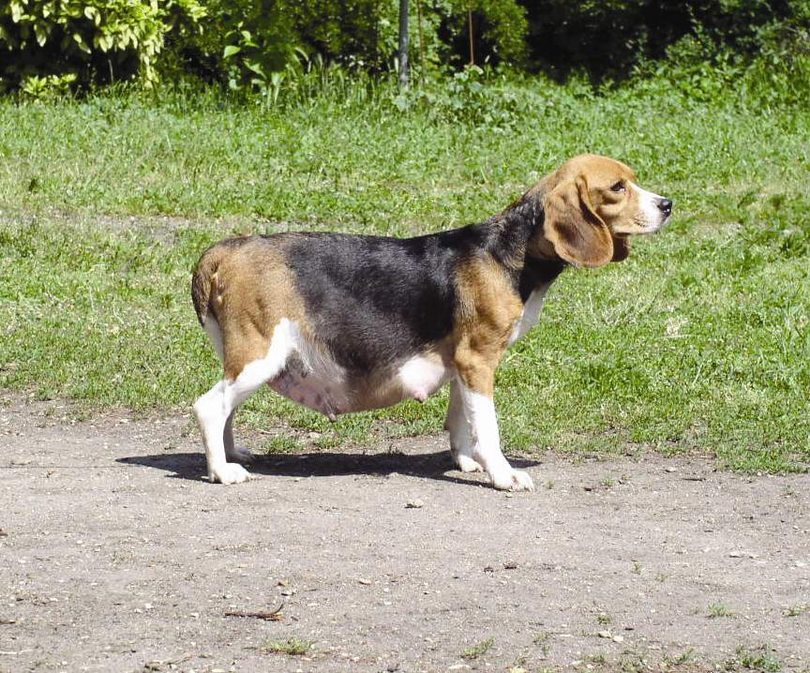
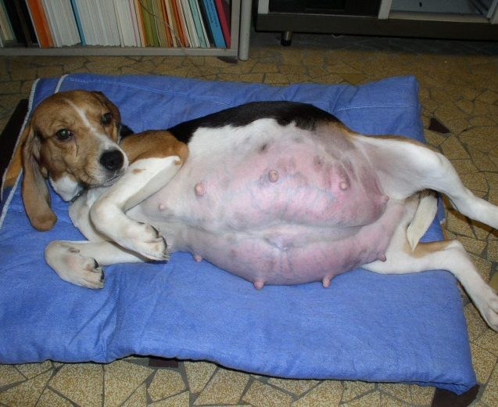
In the same time, food intake capacity is decreasing
Uterus compresses the stomach
Behavioural changes
Notes:
When energetic needs are increasing, the food intake capacity is decreasing due to:
The size increase of the uterus: it compresses the stomach and the bitch can eat a lot of food:
Behavioural changing: the bitch is preparing the nest and sometimes its appetite is decreasing.

Slide 33

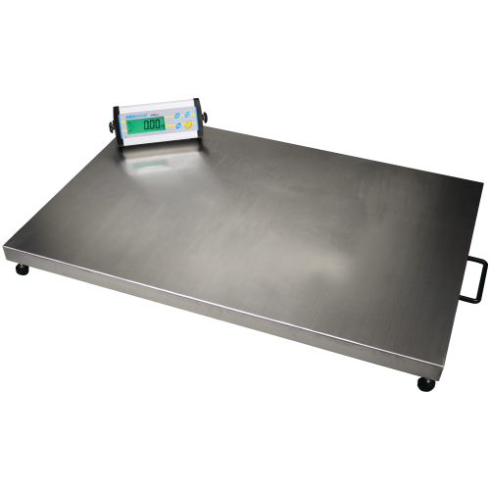

Necessity to use a palatable food with a high energy level
Good practice
Foetal
growth
↓ Ingestion
capacity
Behavioural
changes
High energy
food
Palatable
Avoid unlimited food distribution during gestation!
Notes:
To sum up, high energy needs is a common nutritional need of all those dogs for different reasons:
For the gestating mother: because of the fœtal growth & because of the decrease of the ingestion capacity;
For the gestating bitch: because of extreme energy needs (the same than a sporting dog that is running 60 km a day);
For weaning puppies because they are in the energetic gap: their energy needs are increasing and on the same time, the lactation is decreasing.

Slide 34
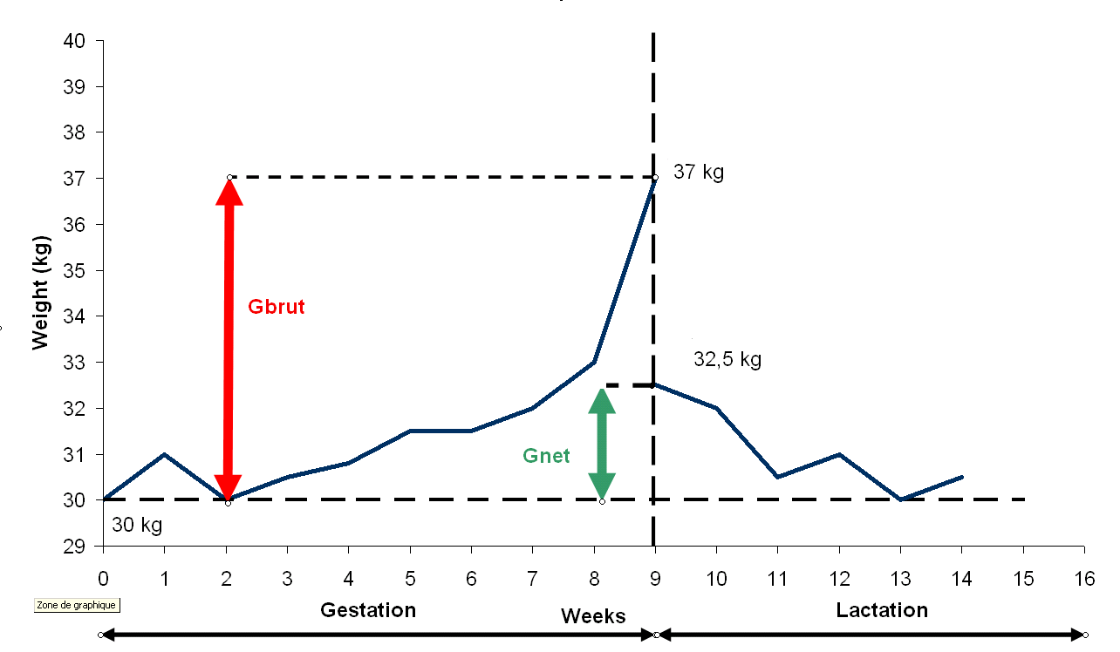
Optimal weight of pregnant bitches
G gross = weight (just before delivery) – Weight (pre-mating) = 15 – 25 %
G net = weight (post-delivery) – weight (post mating) = 5 – 10 %
G gross= 15-25 %
G net= 5-10 %
Greco D. Nutritional Supplements for Pregnant and Lactating Bitches. Topics in Companion Animal Medicine, 2009; 24 (2) : 46-48.
Notes:
The increase of weight during gestation occurs almost at the end of gestation.
The Total Gain (difference between the weight just BEFORE delivery and the weight at the beginning of heats) has to be checked.
As the Net Gain (difference between the weight just AFTER delivery and the weight at the beginning of heats)

Slide 35
Link between food and breeding performances
Quality
Food
Quantity
Decrease
No effect
Improve
Breeding performances

Slide 36

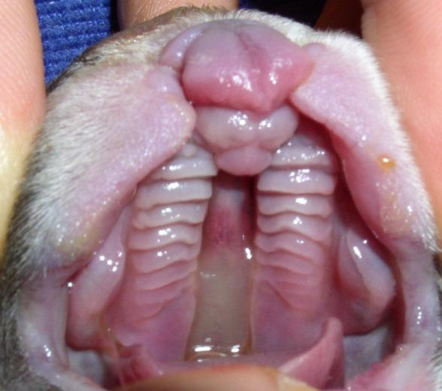
Cleft lip and palate
Notes:
Cleft palate is an arrested development of the upper lip and future nasal and maxillary buds that should normally ends on the 33rd day of gestation in dogs

Slide 37



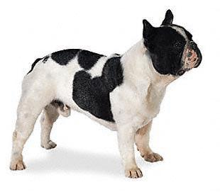
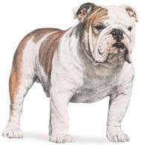

Cleft palates : a main concern in dogs
Prevalence ⁽¹⁻²⁾
4.2 – 17.6 %
1- Domoslawska A. et al. Polish journal of Veterinary Sciences, 2013 (16) 1 : 33-37
2- Elwood JM. et al. New Zealand Veterinary Journal, 1997 (45) 6 : 254-256

Slide 38



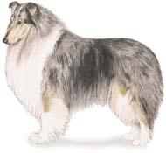


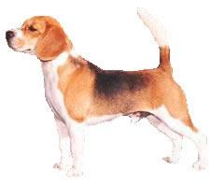
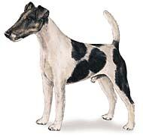




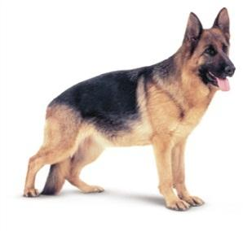


Cleft palate affects many dogs breeds
Notes:
This disease can affected all breeds

Slide 39
…. But mainly brachycephalic breeds
Notes:
But brachycephalic breeds are predisposed to this problem.

Slide 40
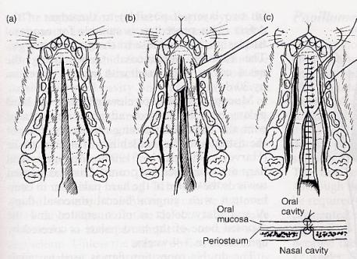
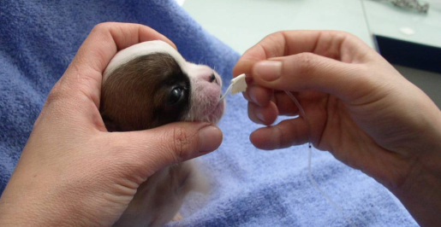
Cleft palate : gestion and treatment
Notes:
Puppies with cleft palate need to be fed with a tube feeding until 2 months of age. At this age a surgery can be beformed by the vet in not too severe cases.

Slide 41

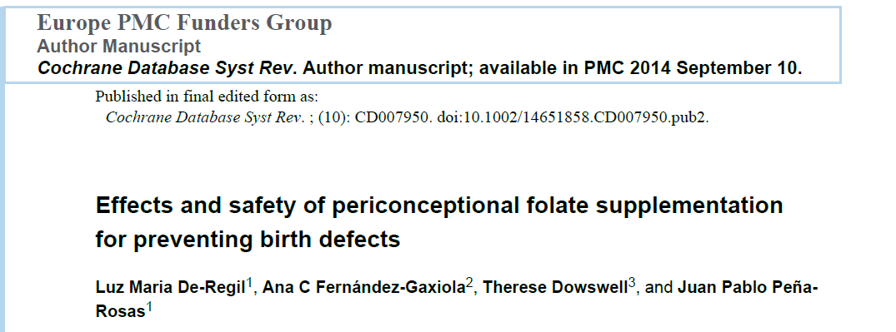
In Humans, supplementation with folic acid decreases the risk of cleft palate
Review of 5 trials
=
6105 women
400 μg of folic acid / day/ woman
5 mg of folic acid / day/ woman
Notes:
In human medecin, supplementation with folic acid decrease risk of cleft palate.

Slide 42


A low folate concentration is frequent in dog
1990 – 2002
9960 dogs from 40 breeds
14 %
Low folate concentration
45 reproductive bitches presented for a heat follow up
11 %
* Dandrieux JRS et al Canine breed predispositions for marked hypocobalaminaemia or decreased folate concentration assessed by a laboratory survey. Journal of Small Animal Practice (2013) 54, 143–148
** Grellet A et al. A high folic acid diet increases folate serum concentration in pregnant bitches. EVSSAR congress 2014. Wroclaw, Poland
Notes:
This percentage of deficiency observed in this study is confirmed by a recent publication. On this huge study with more than 9000 dogs, it was shown that 14% of dogs presented a low level in blood folate and espacially boxer and retriever.

Slide 43
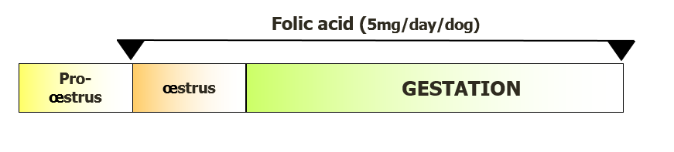
Folic acid during early gestation reduces the incidence of cleft palate
Boston terrier
French Bulldogs
242 puppies
544 puppies
Frequency of cleft palate
Frequency of cleft palate
%
%
-76%
-56%
17.6
9.6
4.2
5.1
Control
Supplemented
Control
Supplemented
Elwood JM. et al. New Zealand Veterinary Journal, 1997 (45) 6 : 254-256
Del Carro et al. EVSSAR congress 2014. Wroclaw, Poland
Notes:
In Boston terrier, supplementation with folic acid (0,5 mg/kg/day) during embryogenesis reduces the incidence of cleft palate from 17.6 % to 4.2 %.

Slide 44
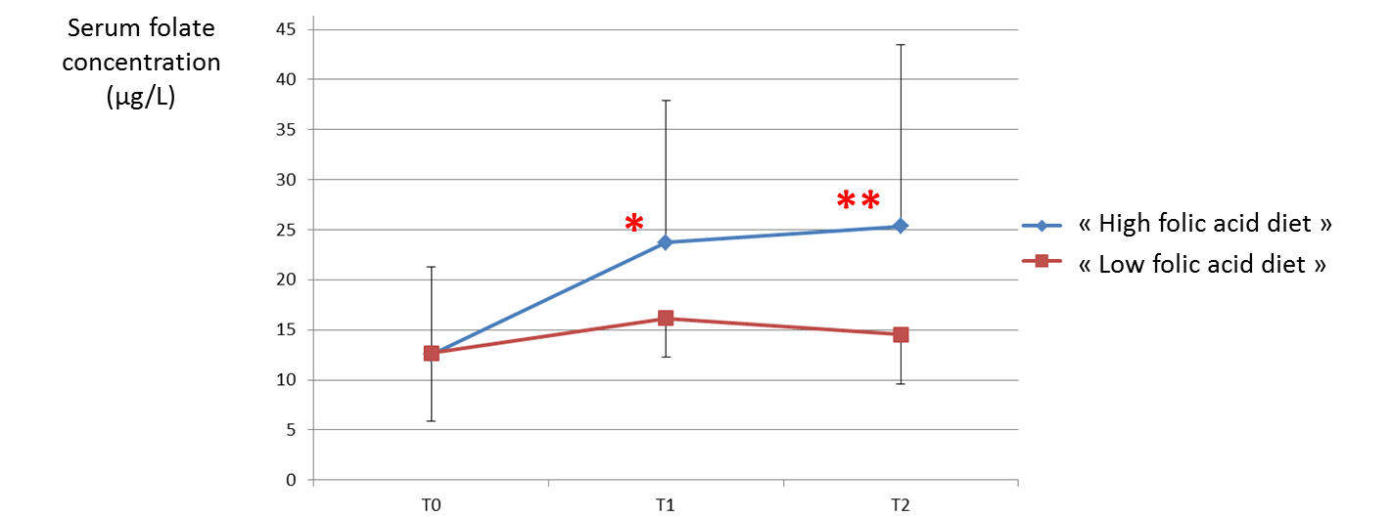
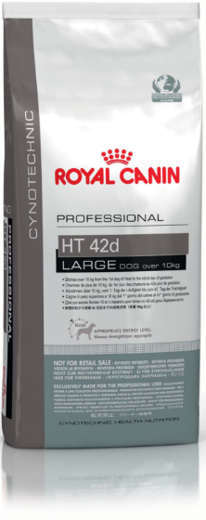
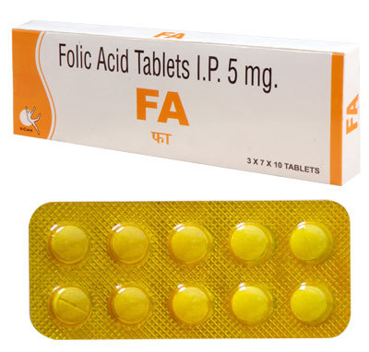
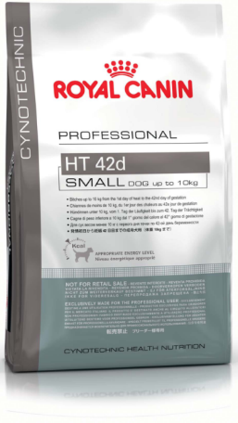
Two ways to increase serum folic acid level
Two ways to increase folic acid level
Ovulation
Mating
25 days of gestation
Grellet A et al. A high folic acid diet increases folate serum concentration in pregnant bitches. EVSSAR congress 2014. Wroclaw, Poland

Slide 45
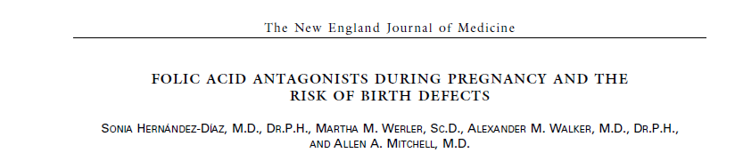
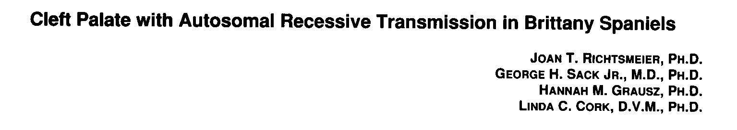
Folic acid and cleft palate… BUT don’t forget the other causes
Collaboration with vets
Selection of dogs by breeders
Notes:
Folic acid helps in the prevention of cleft palate in case of folic acid deficiency. However some drugs can have some teratogenic effects. That’s why vets need to be aware that the bitch is pregnant. There is also an impact of genetic on the transmission of cleft palate a selection of dogs by breeders is important.

Slide 46
Link between food and breeding performances
Quality
Food
Quantity
Decrease
No effect
Improve
Breeding performances

Slide 47
Eclampsia
Clinical signs in case of eclampsia
Muscle tremors, fasciculations
Generalized seizures
Muscle cramping or pain
Behavior changes
Poor activity
Low blood
Calcium concentration

Slide 48
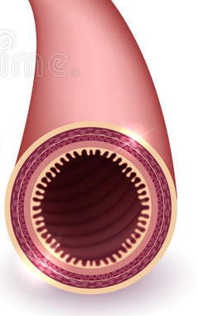
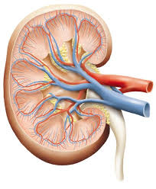

Parathyroid hormone
(PTH)
Ca²⁺
Extracellular calcium (Ca²⁺)
Ca²⁺
Ca²⁺
Soft tissu calcium

Slide 49
Parathyroid hormone
(PTH)
Ca²⁺
Extracellular calcium (Ca²⁺)
Ca²⁺
Ca²⁺
Lactation

Slide 50
Risk factors of eclampsia
1- Calcium supplementation during gestation
Parathyroid hormone
(PTH)
Ca²⁺
Ca²⁺
Extracellular calcium (Ca²⁺)
Ca²⁺
LOW
Soft tissu calcium

Slide 51
Parathyroid hormone
(PTH)
Risk factors of eclampsia
1- Calcium supplementation during gestation
2-Low quality diet
3-High quantity of legumes (phytates)
Ca²⁺
Extracellular calcium (Ca²⁺)
Ca²⁺
LOW
Ca²⁺
Soft tissu calcium

Slide 52
Prevention of eclampsia
High quality balanced diet
No calcium supplementation during gestation

Slide 53
Good breeding performances if…..
Nutrition
Environment
Management of reproduction
Age
Stress
Infectious disease
Genetic
Breed
Behavior

Slide 54



The two main causes of infertility
50 %
2nd
Notes:
Keep in mind that 50 % of infertility cases are due to problem in the determination of the optimal mating time. Vaginal smear AND progesterone assays are two interesting tests in order to define the optimal mating time. The secon main cause of infertility come from the male dog (poor semen quality).

Slide 55
How to optimize breeding performances
+
=
Optimal kennel management
Optimal nutrition
Best results

