Slide 1
How nutrition can influence breeding performances in cat ?
Aurélien GRELLET, DVM, PhD
Toulouse National Veterinary School
Toulouse, France

Slide 2

What does it mean « good breeding performances » ?

Slide 3
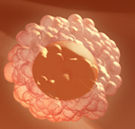
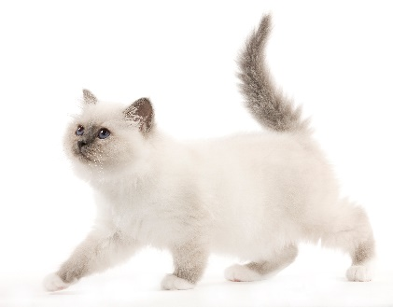
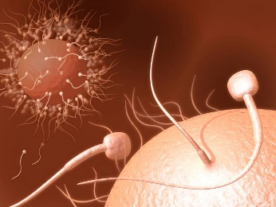
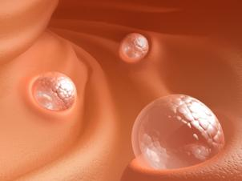
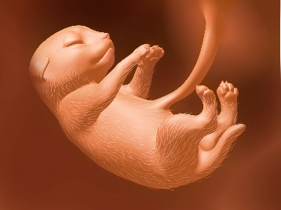
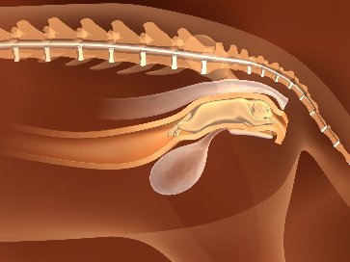
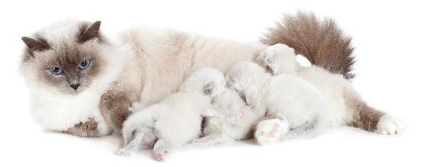

Good breeding performances if…..
Good ovocyte quality
High number of ovocytes
A lot of healthy kittens with a healthy mother
No embryonic
death
No foetal
death
No dystocia
Healthy female
Good body condition
Good milk
(quality + quantity)
No neonatal death
Good birth weight
Optimal growth
Healthy kittens
Good semen quality
Good mobility High concentration Normal morphology

Slide 4
How food can influence breeding performances ?

Slide 5
How food can influence breeding performances ?
Ingredients
Intentionally introduced substances
Nutrients Fat/Proteins/Carbohydrates/Vitamins/Minerals
Food additive
Preservative, flavors
Unintentionally introduced substances
Biological :
Mycotoxins, viruses, parasites, bacteria
Chemical :
Pesticide residues, vet drugs containants, environmental contaminants…)
Diet
Storage
Animal
Temperature
Humidity
Packaging
Time
Cleanliness
Insects rodents
Digestion
Nutrient profiles
Ingestion
Formulation
Absorption
Process
Quantity
Nutritional needs
Maintenance
Reproduction
Oestrus
Gestation
Lactation
Growth
Semen quality

Slide 6
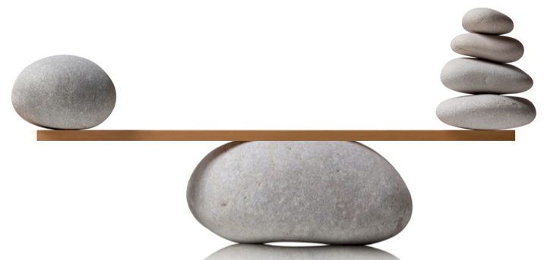
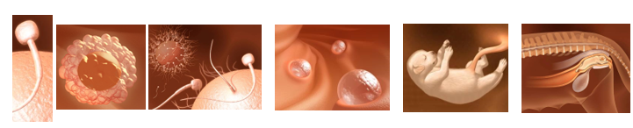
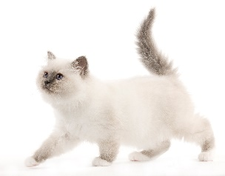

Link between food and breeding performances
Quality
Food
Quantity
Decrease
No effect
Improve
Breeding performances

Slide 7
Raw meat diets → nutritional concerns and safety risk
Nutritional concerns
Safety risks
60 %
Major nutritional imbalances
21 – 48 %
Contaminated by Salmonella sp
95 homemade raw meat diets analyzed
Campylobacter spp
Toxoplasma gondii
Freeman L et al. Current knowledge about the risks and benefits of raw meat-based diets for dogs and cats. JAVMA, 2013, 243 (11) : 1549-1558

Slide 8
Link between food and breeding performances
Quality
Food
Quantity
Decrease
No effect
Improve
Breeding performances

Slide 9
Modification of the diet can influence breeding performances
Queens
65
72
72
73
Kittens
423
510
557
924
1979
1980
1981
1982
Diet modification
Litter size
4,5
4,3
5,4
5,5
High quality and high fat diet improved reproduction
Stillborn + dead < 7 days
20,6 %
14,2 %
6,7 %
5,3 %
Dead > 7 days
2,4 %
3,2 %
3,4 %
3,5 %
Olovson SG. Diet and breeding performance in cats. Laboratory animals (1986), 20 : 221 – 230.

Slide 10
Link between food and breeding performances
Quality
Food
Quantity
Decrease
No effect
Improve
Breeding performances

Slide 11
Consequences of overfeeding before and during gestation

Slide 12
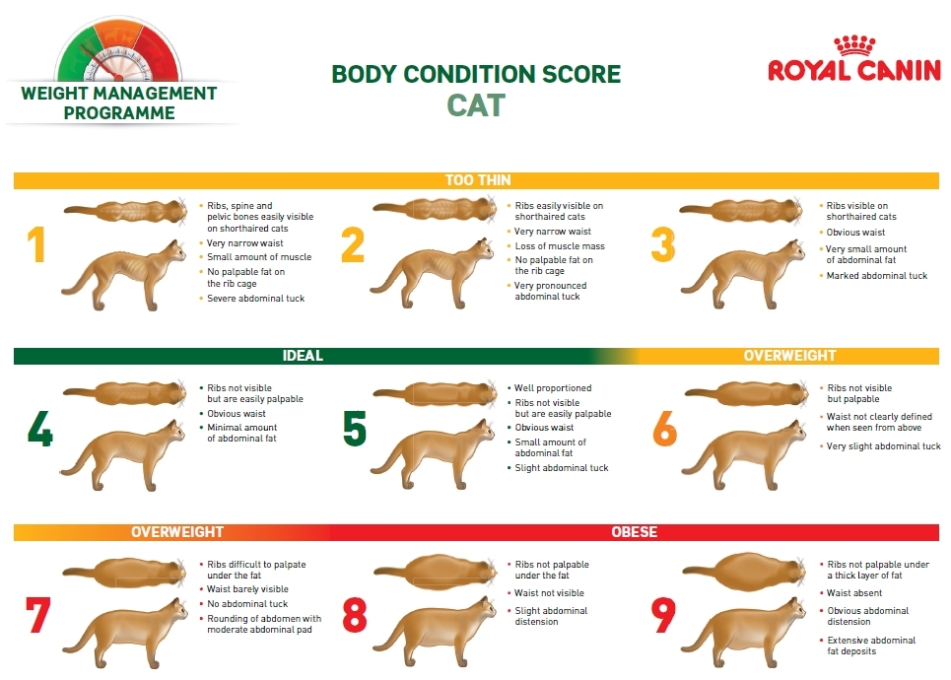
A scale to evaluate body condition score
Notes:
Today the body condition score is evaluated thanks a 9 points scale. A dog with a score at 4 or 5 is in an optimal body score. On the contrary a dog with a score of 1 is cachectic (no more fat) and a dog with a score of 9 is obese.

Slide 13
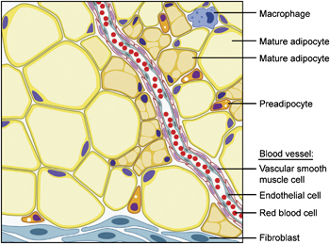
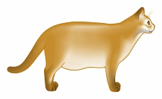
Leptin : a peptide hormone secreted by adipocytes
Plasma leptin concentration
(ng/ml)
Leptin
Body fat mass
(kg)
Appleton DJ et al. Plasma leptin concentrations in cats: reference range, effect of weight gain and relationship with
adiposity as measured by dual energy X-ray absorptiometry. JFMS (2000) 2, 191–199
Notes:
Obese dogs have a higher quantity of fat. If we have a look on the composition of fat we can see that fat contained specific cells called adipocytes. Adipocytes are cell full of fat. Fat is an important endocrine tissue which can secrete different hormons one of them is leptin.

Slide 14
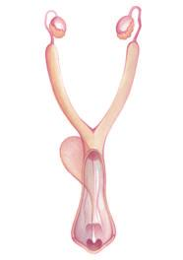

Obesity induces modifications in hormonal secretions
Hypothalamus
GnRH
Leptin
+
Pituitary gland
FSH
LH
+
Progesteron
Estrogen
Notes:
This increase level of leptin could interfere with the secretion of specific hormones like (GnRH, FSH, LH, Progesteron or Estrogen).

Slide 15
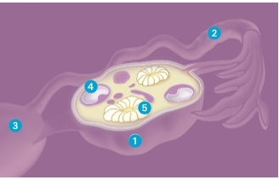
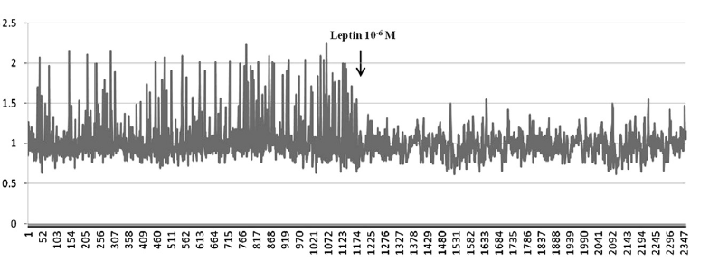
Leptin decrease ovary contractility
Leptin receptors
Ovary contractility
Reduction of frequence
Reduction of tension
Leptin
Ovarian contractions
→ Ovulation
1-Ovary
2-Oviduct
3-Uterine horn
4-Follicule
Time
Trisolini C. Leptin and queen ovary : new insights about ovulation. Research in Veterinary Science 94 (2013) 707-710

Slide 16
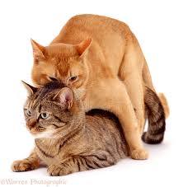
Overweight cat at mating = poor fertility
Poor fertility

Slide 17


Slide 18
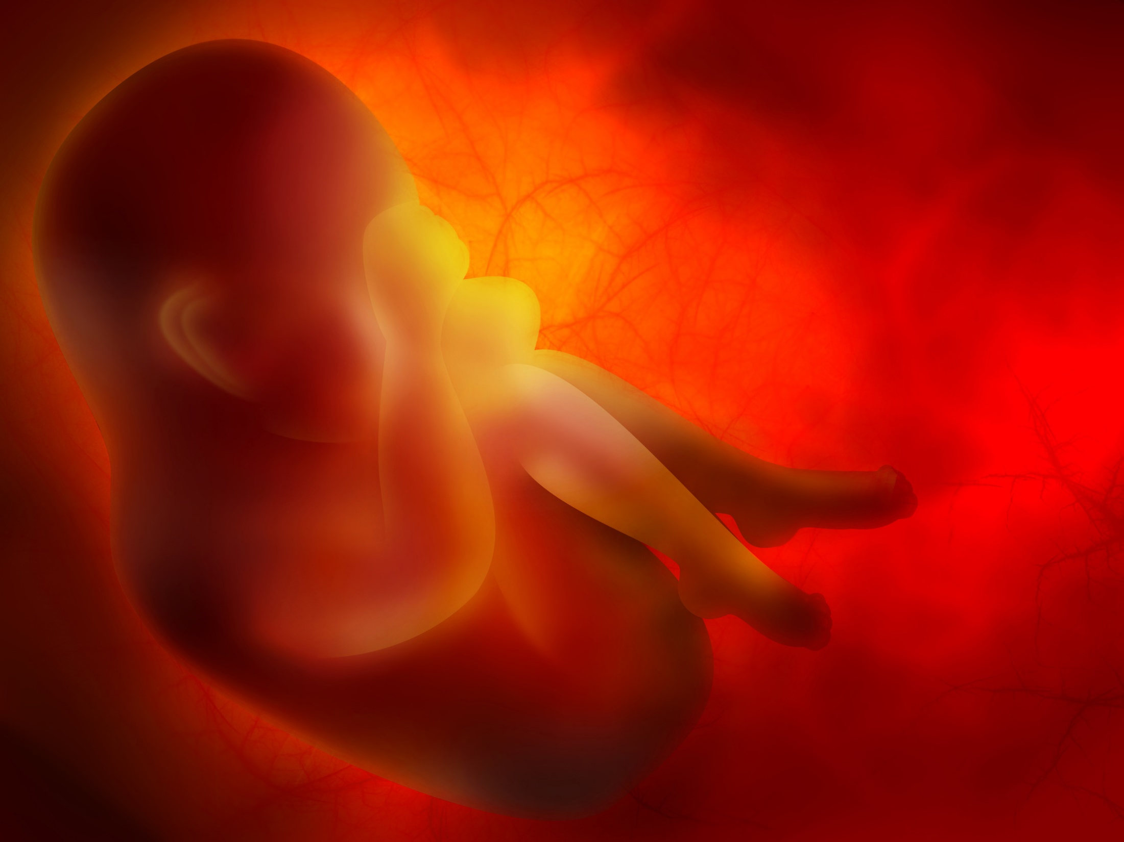
Obesity induces an inflammation of placenta in human
Obese
Inflammatory cells in the placenta
X 4
Lean
Challier JC. et al. Obesity in Pregnancy Stimulates Macrophage Accumulation and Inflammation in the Placenta. Placenta, 2008, 29 (3) : 274-281

Slide 19
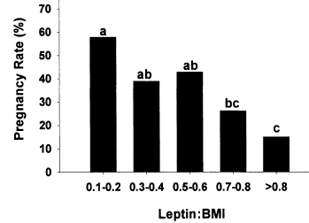
Obesity decreases fertility in human
Brannian JD et al. Baseline non-fasting serum leptin concentration to body mass index ratio is predictive of IVF outcomes. Human reproduction, 2001, 16, 9 : 1819-1826
Notes:
In human, different studies showed that obesity decrease the pregnancy rate as you can see with this study from Brannian.

Slide 20
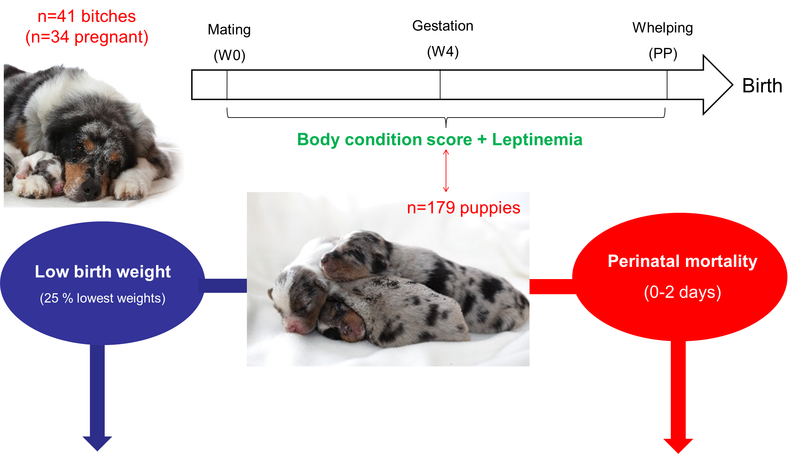
New study done in dog on BCS and reproduction

Slide 21
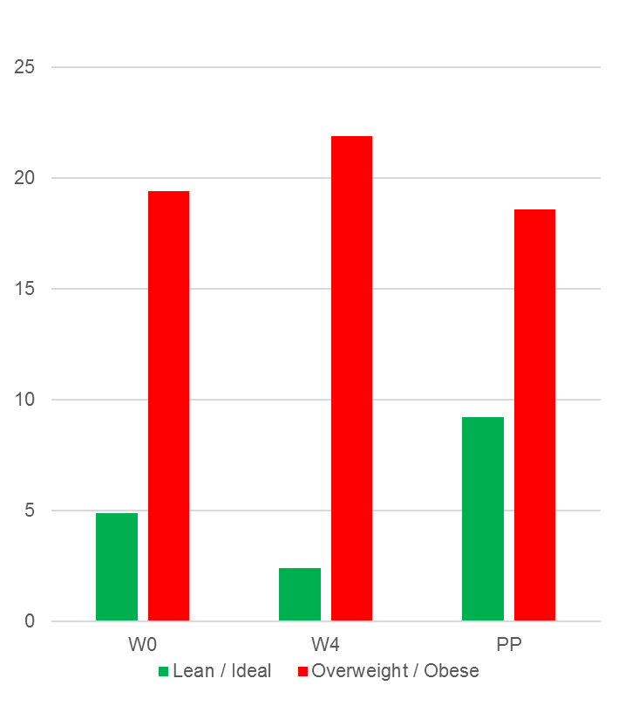
BCS influence prevalence of low birth weight and mortality
Prevalence of low birth weights
22,5 %
Perinatal mortality
25,1 %
Low birth weight puppies (%)
Mortality (0-2 days) (%)

Slide 22
Overweight cat during gestation = poor fertility
Poor fertility
Low birth weight kittens
Neonatal mortality

Slide 24
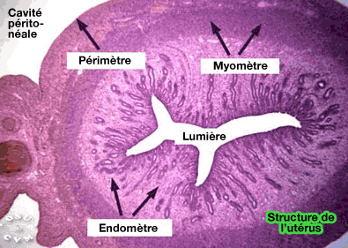

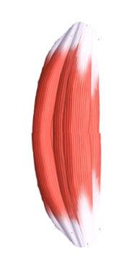

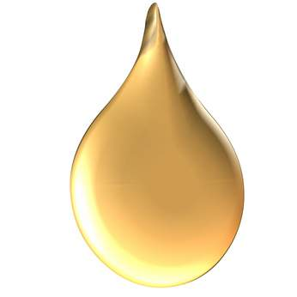
Overweight queens accumulate fat in the uterus
Uterus has a muscle : myometra
Abdominal cavity
Limit of uterus
Myometra
Lumen
Endometra
Uterus
Notes:
24
One consequence of an excess of energy during pregnancy is that fat can be stocked in muscles.

Slide 25


In overweight women, a diminution of myometra contraction is observed
+
mN
Amplitude
mN
Frequency (10 minutes)
Zhang J. et al. Poor uterine contractility in obese women. BJOG 2007;114:343–348
Notes:
25
This accumulation of fat can decrease muscle contraction so uterine contraction. This phenomena was well described in women. As you can see on this figure from Zhang overweight and obese women present a diminution of uterine contraction as you can see here.

Slide 26
Overweight is frequent in pure breed cats
4,5 %
45,5 %
268 cats
22 breeds
2 cat shows
Corbee RJ (2013). Obesity in cat show. J Anim Physiol Anim Nutr (Berl). 2014 Dec;98(6):1075-80.

Slide 27

Assessment of body condition score before the mating
Only healthy queens in a good body condition score should be used for breeding
Notes:
So all the data underline the necessity to assess body condition score before the mating. Only healthy dogs in a good body condition score should be used for breeding.

Slide 28

How to feed the cat during pregnancy ?

Slide 29

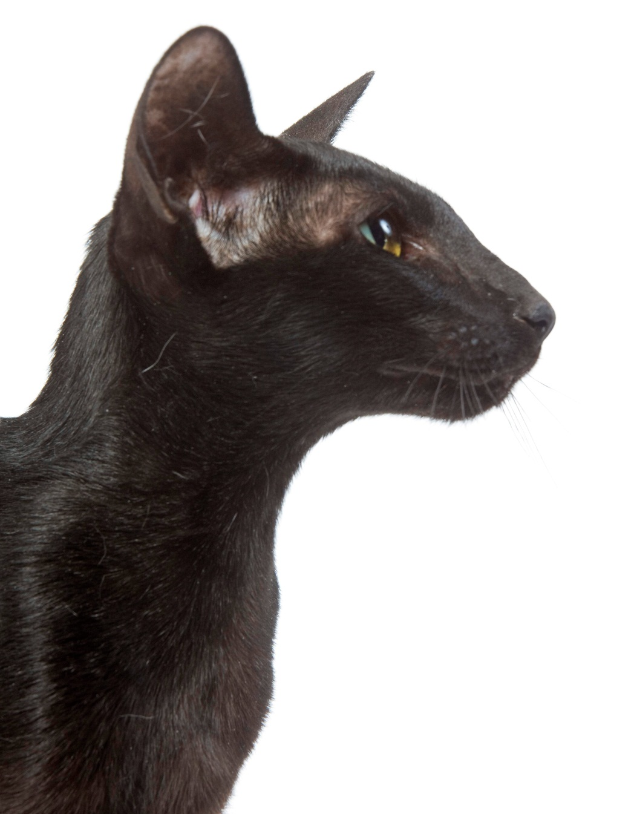
In Carnivores, there are two strategies to produce milk

Slide 30

Optimal weight of pregnant bitch
G gross = weight (just before delivery) – Weight (pre-mating) = 15 – 25 %
G net = weight (post-delivery) – weight (post mating) = 5 – 10 %
Weight (Kg)
G gross= 15-25%
G net= 5-10 %
Weeks
Gestation
Lactation
Greco D. Nutritional Supplements for Pregnant and Lactating Bitches. Topics in Companion Animal Medicine, 2009; 24 (2) : 46-48.

Slide 31
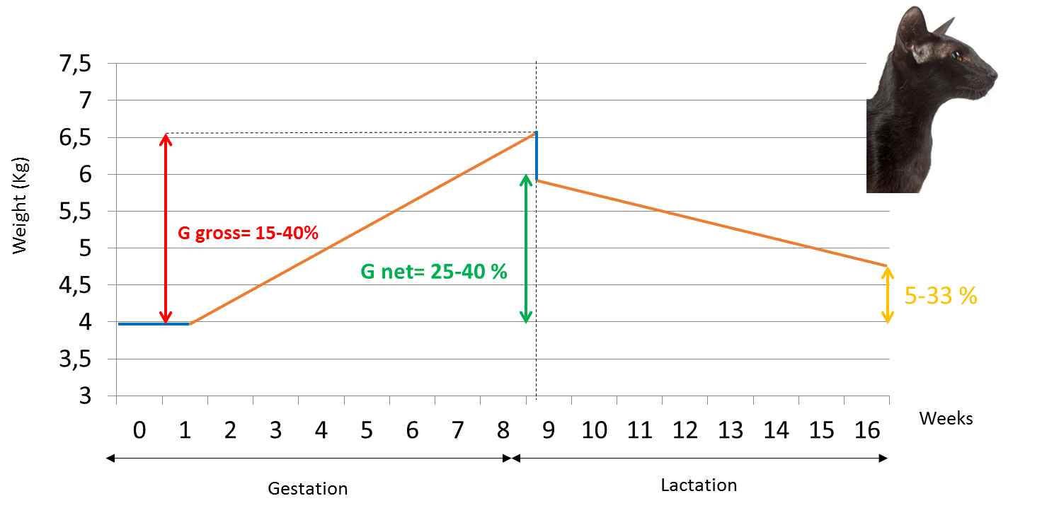
Optimal weight of pregnant queen
Wichert D et al . Cats during gestation and lactation fed with canned food ad libitum: energy and protein intake, development of body weight and body composition. JAPAN 2011

Slide 32


Dogs and cats two strategies during pregnancy
Bodyweight
(% weight at mating)
Days after mating

Slide 33
In Carnivores, there are two strategies to produce milk
More energy
reserve
Energy comes
only
from food
Energy comes
from body
fat deposit
& food
Few energy
reserve

Slide 34
Is it possible to modulate milk composition with nutrition during gestation ?

Slide 35
Four different factors influence the composition of domestic cat milk
Litter size
Diet
Milk composition
Stage of lactation
Teat location
Jacobsen KL. et al. Influences of stage of lactation, teat position and sequential milk sampling on the composition of domestic cat milk (Felis catus). J. Anim. Physiol.a. Anim. Nutr. 88 (2004), 46-58

Slide 36
Four different factors influence the composition of domestic cat milk
Litter size
Diet
Milk composition
Stage of lactation
Teat location

Slide 37
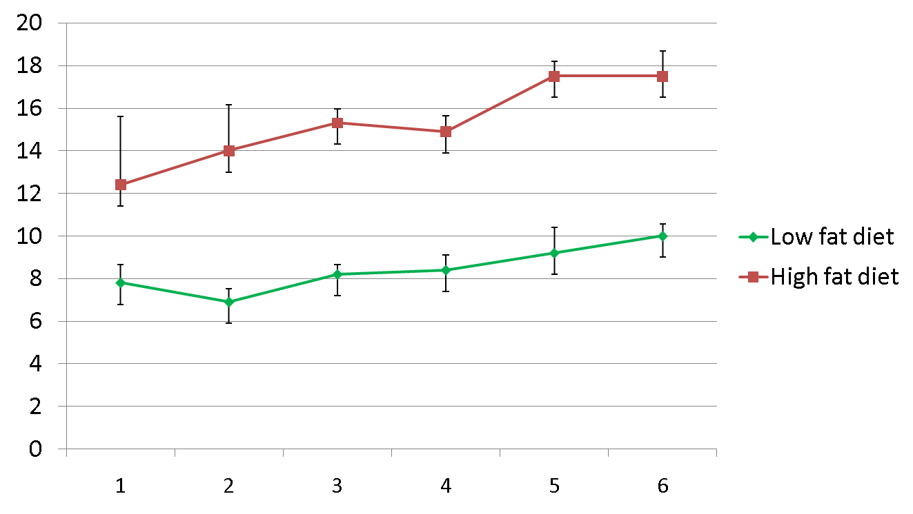
Diet and number of weeks of lactation have an impact on the composition of cat milk
% of fat in the milk
High fat diet
Low fat diet
Number of weeks of lactation

Slide 38
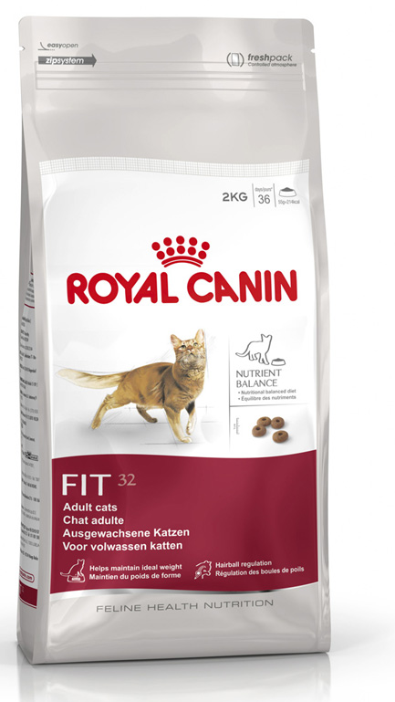
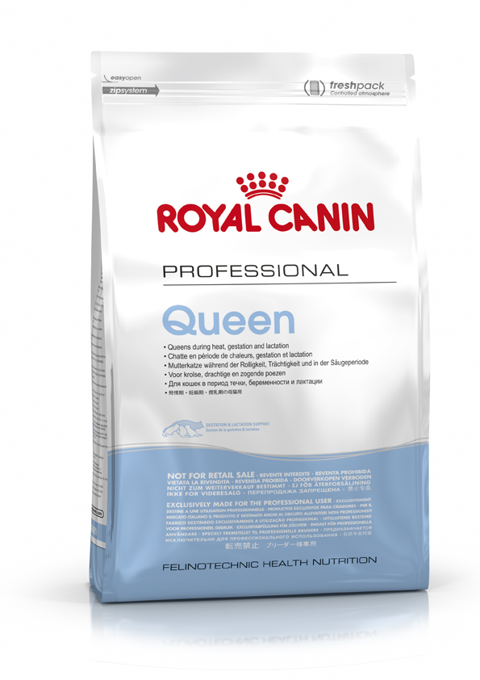
Use specific diet dedicated for gestation and/or lactation
388,5 g of fat / 1000 Kcal
549,2 g of fat / 1000 Kcal

Slide 39
Do we need to give supplements of the queen during gestation ?

Slide 40
Eclampsia
Clinical signs in case of eclampsia
Muscle tremors, fasciculations
Generalized seizures
Muscle cramping or pain
Behavior changes
Poor activity
Low blood
Calcium concentration

Slide 41
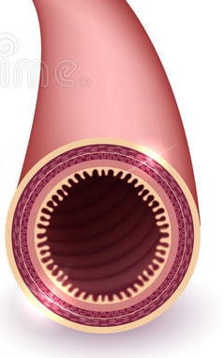
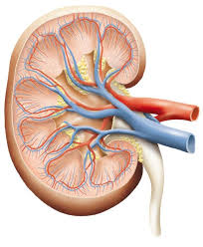
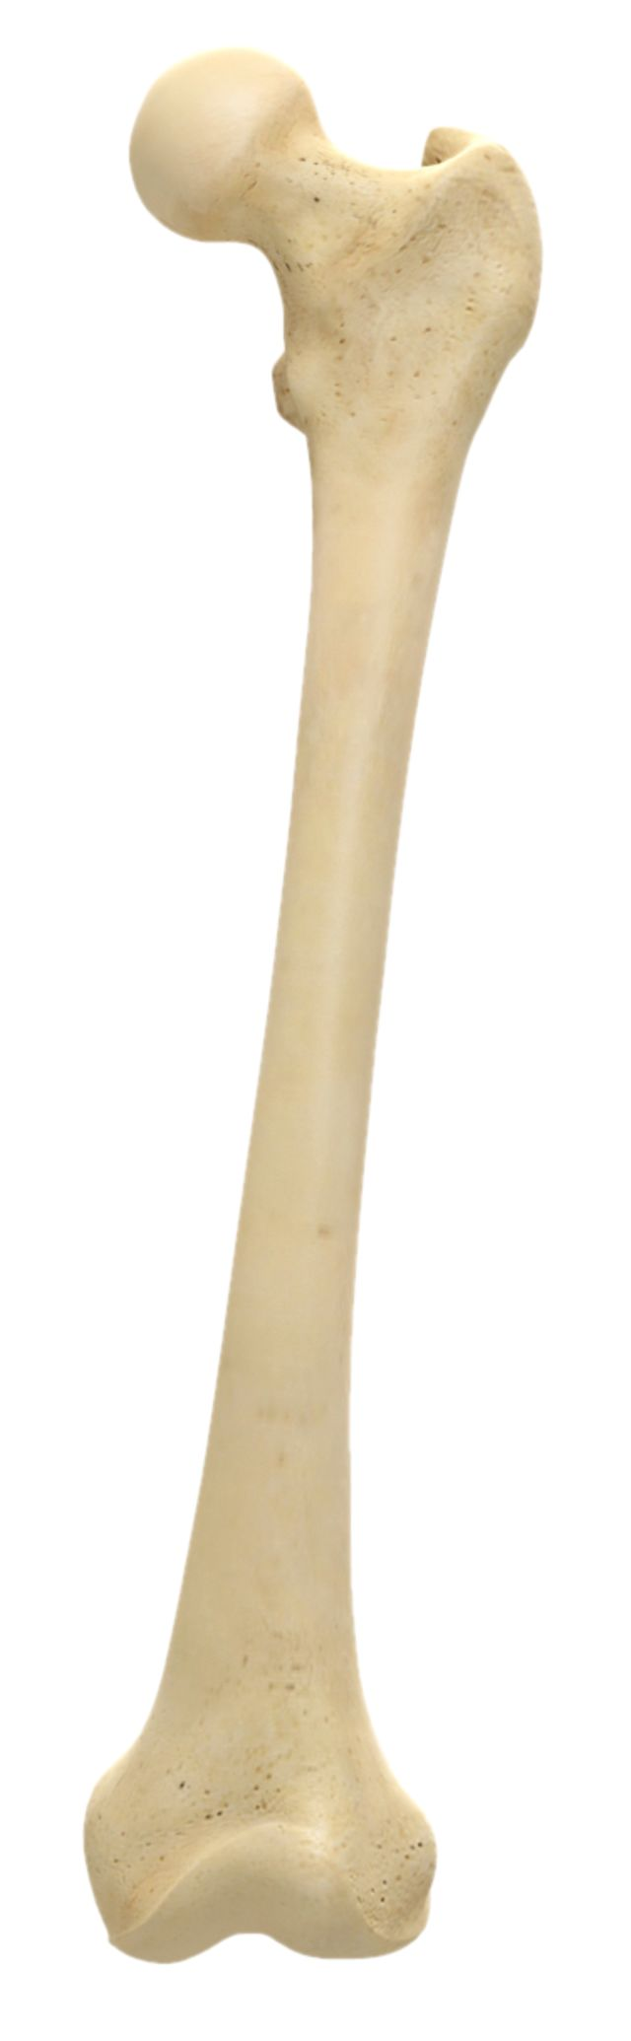
Parathyroid hormone
(PTH)
Ca²⁺
Extracellular calcium (Ca²⁺)
Ca²⁺
Ca²⁺
Soft tissu calcium

Slide 42

Parathyroid hormone
(PTH)
Ca²⁺
Extracellular calcium (Ca²⁺)
Ca²⁺
Ca²⁺
Lactation

Slide 43
Risk factors of eclampsia
1- Calcium supplementation during gestation
Parathyroid hormone
(PTH)
Ca²⁺
Ca²⁺
Extracellular calcium (Ca²⁺)
Ca²⁺
LOW
Soft tissu calcium

Slide 44
Parathyroid hormone
(PTH)
Risk factors of eclampsia
1- Calcium supplementation during gestation
2-Low quality diet
3-High quantity of legumes (phytates)
Ca²⁺
Extracellular calcium (Ca²⁺)
Ca²⁺
LOW
Ca²⁺
Soft tissu calcium

Slide 45
Prevention of eclampsia
High quality balanced diet
No calcium supplementation during gestation

Slide 46
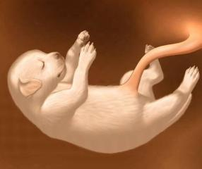
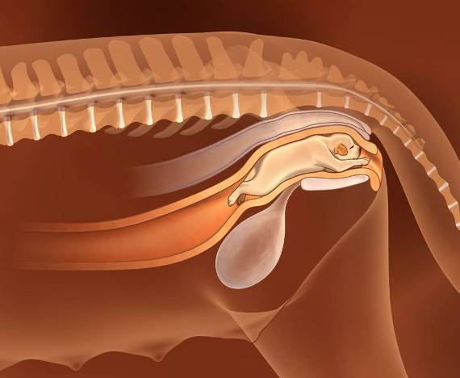
Good breeding performances if…..
Nutrition
Environment
Management of reproduction
Age
Stress
Infectious disease
Genetic
Breed
Behavior

Slide 47
How to optimize breeding performances
+
=
Optimal kennel management
Optimal nutrition
Best results

